Slide 1
Non Profit and Faith Based Agencies, and the role of Information Technology
Lakewood Resource & Referral Center
212 2nd Street Suite 204
Lakewood, NJ 08701

Slide 2
The Topics We’ll be Covering
Appreciating the Benefits
Ethical Issues
Privacy and personal information
Freedom of speech in cyberspace
Intellectual property
Cyber crime
Broader Impacts of Information Technology

Slide 3
Appreciating the Benefits

Slide 4
Appreciating the Benefits
Entertainment-games-DVD’s, etc.
World Wide Web and the Internet
Business data
E-mail and e-commerce
Digital libraries
Automobiles/trucks/hybrid cars, ABS brake sensors, night vision drivers
Etc…

Slide 5
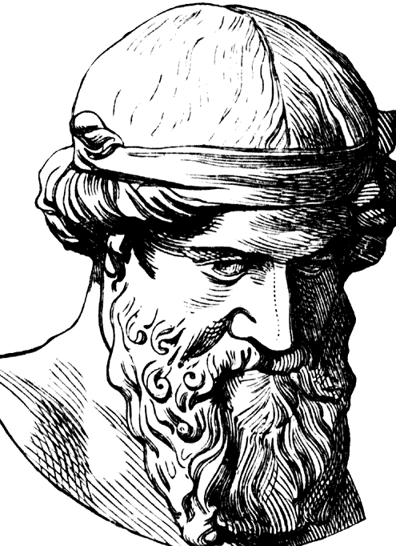
Ethical Issues

Slide 6
Ethical Issues
Privacy and personal information
Freedom of speech in cyberspace
Intellectual property
Cyber crime

Slide 7
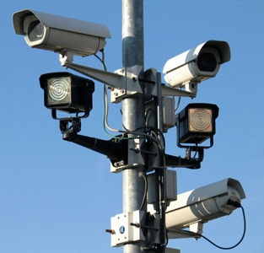
Privacy and IT

Slide 8
Privacy and IT
What are the privacy Issues related to IT?
Freedom from intrusion of unwanted information into one’s personal space. There is no privacy violation if information is obtained or published with the person’s consent.
Spam
Unsolicited Commercial (UCE)
Freedom from surveillance and improper access by computer hacking (monitoring, tracking/interception)
Cookie-Encryption
Autonomy over personal data collected and disclosed to others
Theft
Phishing
Anonymity-Discuss under 1st Amendment

Slide 9
Privacy and IT
Freedom from surveillance & improper access by others (improper monitoring, tracking, hacking & interception)
Cookies--Website stores information about visitor’s activity (data spillage--allow advertiser’s to use this information or leaks due to the complexity of the software
Spyware--surfing monitors, buying habits, keystroke monitors.
Secondary Use of Information
Sale of consumer information
Computer matching-comparing databases
Detecting fraud,
Law enforcement

Slide 10
Privacy and IT
Autonomy over personal information collected & disclosed by others
Biometrics (Identification of bodily indicators such as fingerprints, iris, bone structure in the hand, etc).
School ID’s and civil liberties
How do you design privacy safeguards? Build them into system rather than retrofit a complex system
Guard against theft, make system trustworthy, update system without infringing on civil liberties
Phishing
Email or access link containing request for data and it is fraudulent
Debate over National ID Card-HR 418 and/or Standardized driver’s licenses.

Slide 11
Privacy and IT
What Privacy Protection and Regulations exist?
4th Amendment-protection against intrusion
Philosophical-Warren & Brandeis
Free Market v. Consumer Protection view
Contract
Regulations (consider the cost to compliance)---Example: Children’s Online Privacy Protection Act (COPPA)
EU---Comprehensive Privacy Directive--Processing personal data.

Slide 12
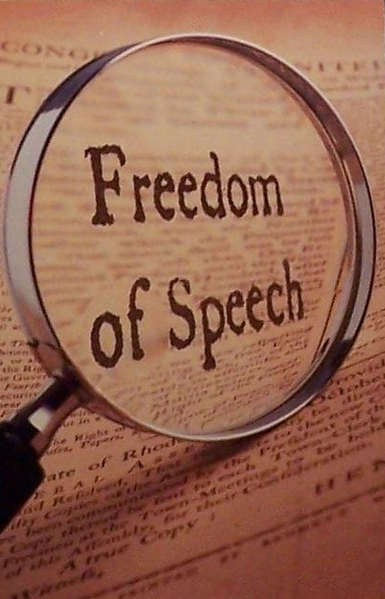
Freedom of Speech

Slide 13
Freedom of Speech
First Amendment
“Congress shall make no law…abridging the freedom of speech, or of the press…”
Protection against objectionable speech, pictures, and other forms of expression of ideas and opinions
Restriction are on “the power of government”, not individuals or private business.
Supreme Ct has developed guidelines
for example advocating illegal acts (usually) and truthful advertising are protected
Anonymity protected.
Libel and direct, specific threats, Inciting violence, in certain circumstances, are all illegal.

Slide 14
Freedom of Speech
Regulatory Paradigm
Federal Election Commission (FEC) regulations restrict anonymity in the form of disclosure and financial requirements established before the Web.
Anonymity on the Internet is taken advantage of for criminal and antisocial purposes.
Children’s Internet Protection Act (CIPA)
Child Online Protection Act (COPA) 1998
Supreme Ct found it unconstitutional. Targets Internet terminals in schools and libraries that participate in certain federal programs.
Filters better solution

Slide 15
Freedom of Speech
What is illegal?
Obscenity is offensive and not protected by US Constitution. Criteria for obscene material
1) it depicts offensive acts whose depiction is specifically prohibited by state law,
2) it depicts these acts in a patently offensive manner, appealing to prurient interest as judged by a reasonable person using community standards, and
3) it has no serious literary, artistic, social, political, or scientific value.

Slide 16
Freedom of Speech
Is Anonymity Protected?
Right to express political opinion anonymously (in print) is protected .
Right to anonymity by IP is protected.
Providers must have good identity protection programs and must train their employees to monitor policy effectively. [Stems from “sailor case’ AOL employee violated anonymity of customers by selling list and provider held liable].

Slide 17
Intellectual Property

Slide 18
Intellectual Property
Intangible creative work protected
Cheating

Slide 19
Intellectual Property
Legislative History
No Electronic Theft Act (1997)
Fair-Use Doctrine (Copyright Act of 1976)
Sonny Bono Copyright Term Extension Act
Digital Millennium Copyright Act [DMCA] (1998)

Slide 20
Intellectual Property
Ethical argument about copying
Who owns the content ?
What are the rights of the owner of the media? Can they backup their material?
Who should be held liable for infringement
Individual consumer? (Napster)
Internet Service Provider?
What are the rights of business and Universities

Slide 21
Intellectual Property
Peer to Peer
Benefits-allows for Open Source and enhanced research capability and collaboration
Consistent with a network or ecological worldview/paradigm
Downside-copyright infringement

Slide 22
Cyber Crime

Slide 23
Cyber Crime
Exploitation of Minors
Copyright piracy
Consumer fraud
Embezzlement
Attacks on digital assets (computer is the target)
Identity theft
Identity changed (programmer to criminal)
Medical records changed
Life of investigator erased

Slide 24
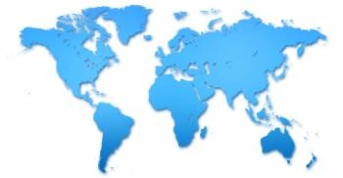
Broader Impact of IT

Slide 25
Broader Impact
Computers and Community
Reduce face to face gathering and hurts local community resulting in “isolation” and eroding the family and community life.
Robert Putman argues that an indicator is the number of clubs that people join--other factors at play including: modern transportation and communication (increased mobility), changes in family patterns and TV.
Addiction to computers and TV
Digital divide---Computer Professionals for Social Responsibility (CPRS) push for universal access.

Slide 26
Broader Impact
Criticism of Computer Technology
Unemployment and deskilling of jobs
“Manufacture needs”
Social injustice
Dehumanizing
Separates humans from nature
Benefits big business and big government
Use in schools thwarts development of social skill, human values, intellectual skills and create an “ominous uniformity of knowledge” consistent with corporate values.

Slide 27
Summing it all Up
Appreciating the Benefits
Ethical Issues
Broader Impact of IT

Slide 28
Thank You.
Q&A

